Slide 1
new_sp_input_test

Slide 2
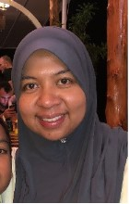
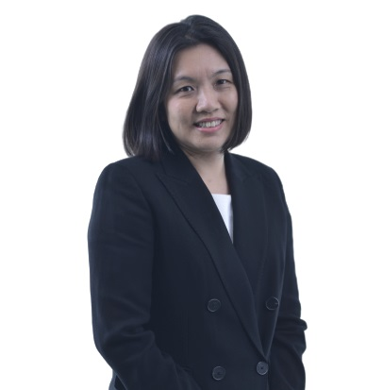
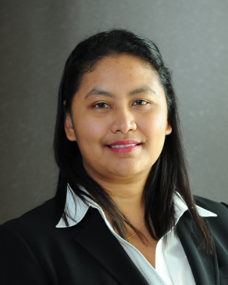
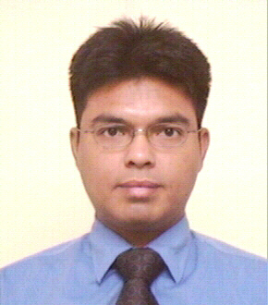

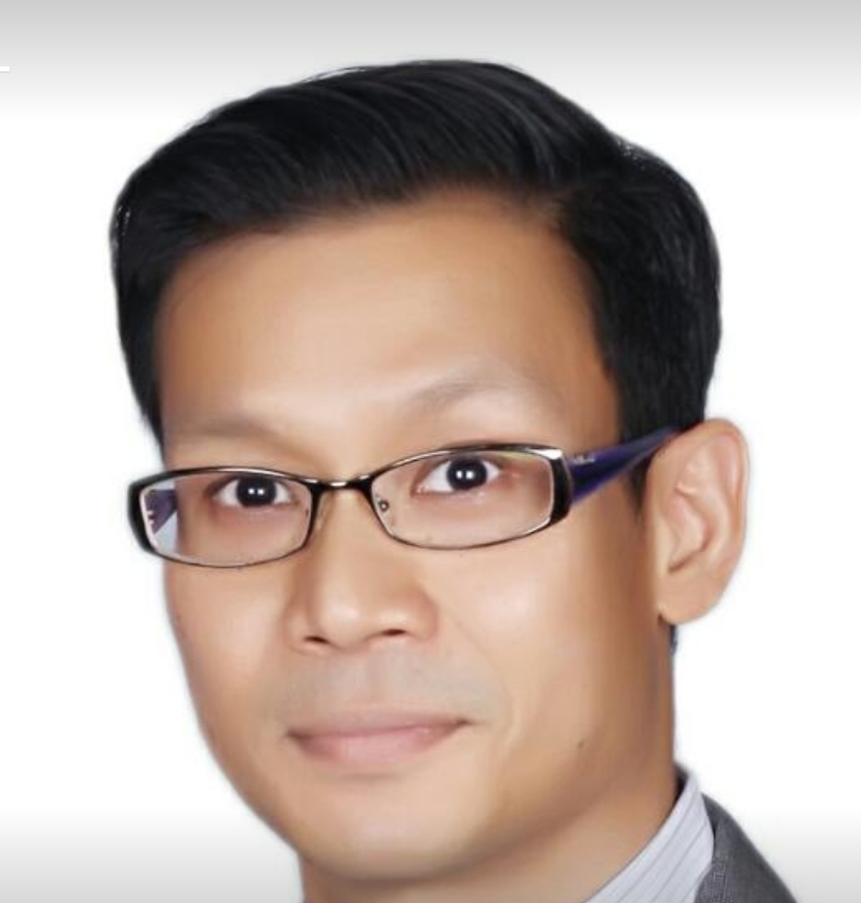
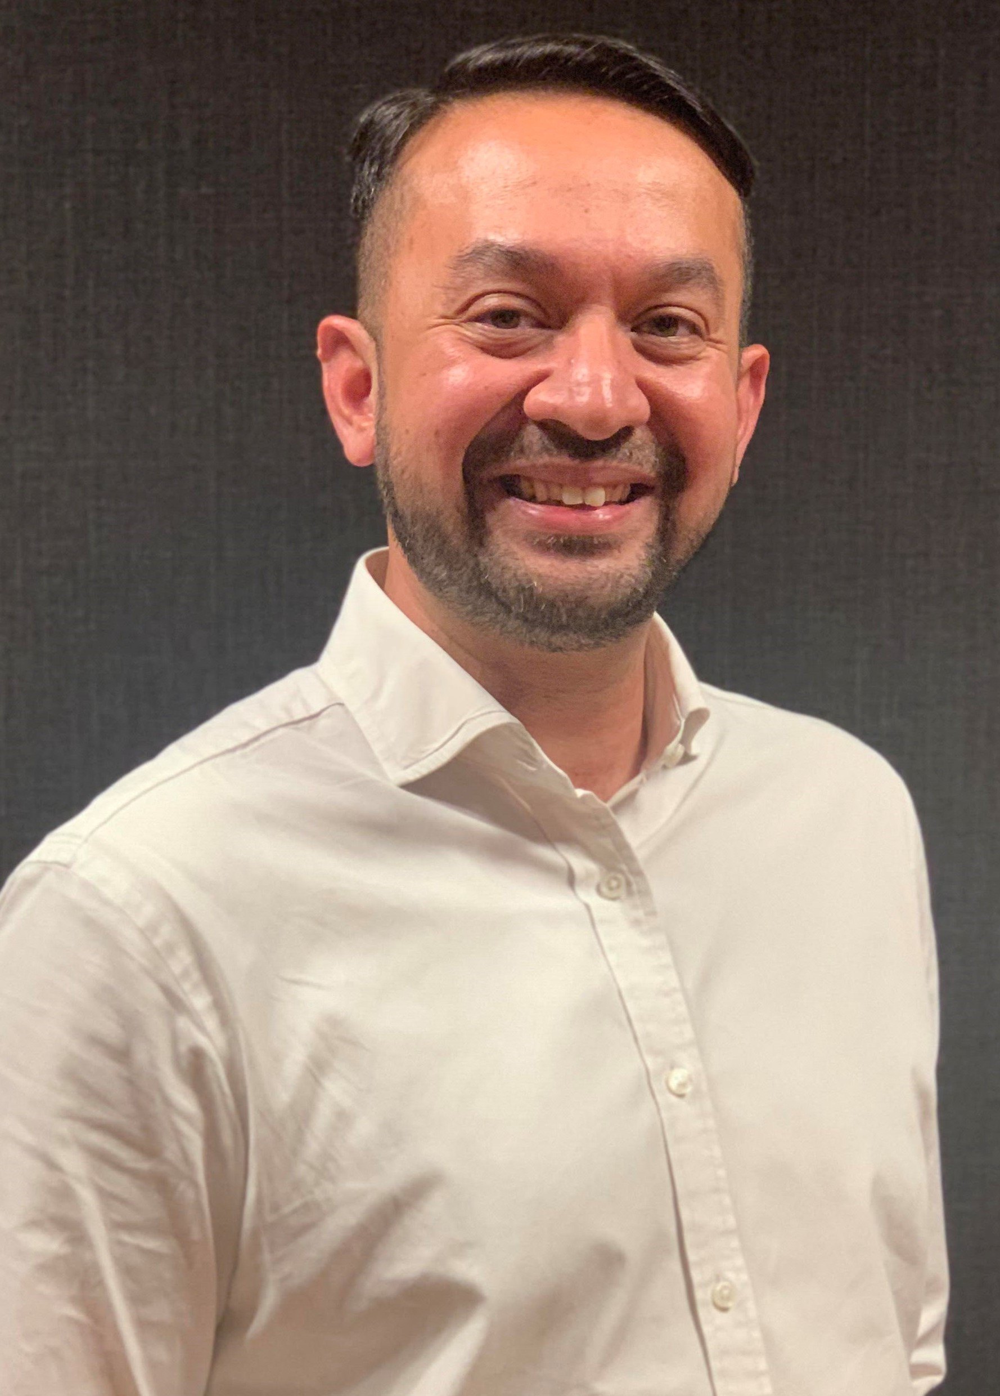
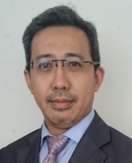
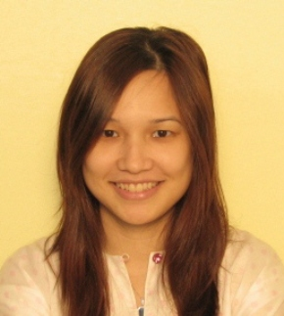
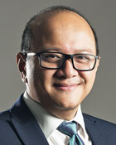
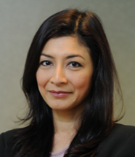
VP GHRM
1st Line |  | 2nd Line |  | 2nd Line
 | Adiana Mastura (G09, CT) |  | Lim Li Ping (G10, CT) |  | Roztini Elyda (G09, BT)
 | Ahmad Zakir(G09, CT) |  | Nazri Idzlan(G09, CT) |  | Omar Nizar(G09, CT)
 |  |  | Ikhwan Hamzah (G10, CT) |  | Muhammad Huzaini (G09, CT)
 |  |  | Mazlin Erawati binti Ab Manan (G10, CT) |  | Shahriman (G09, CT)
 |  |  | Maslina (G10, CT)

Slide 3
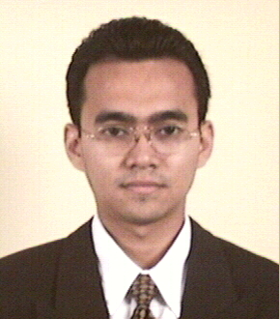
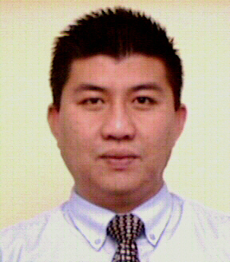
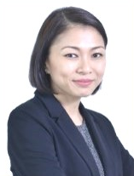
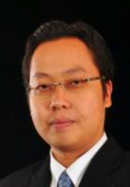
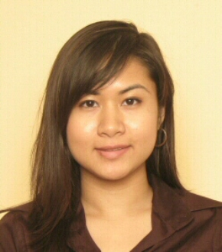
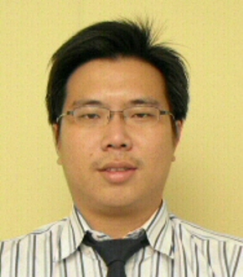
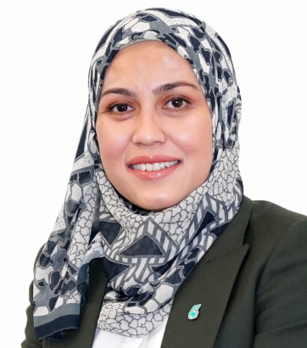
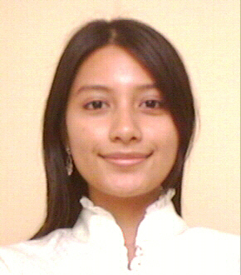
VP GHRM
3rd Line |  | 3rd Line
 | Shamsul Irwan (G08, CT) |  | Hisham (G09, CT)
 | Rozana (G09, CT) |  | Kenny Lim Hock Soon (G07, CT)
 | Azferina (G08, BT) |  | Muhammad Huzaini (G09, CT)
 | Nur Fadillahn (G08, CT) |  | Shahriman (G09, CT)

Slide 4
VP GHRM (2)
1st Line |  | 1st Line |  | 2nd Line
 | Adiana Mastura (G09, CT) |  | Roztini Elyda (G09, BT) |  | Lim Li Ping (G10, CT)
 | Ahmad Zakir(G09, CT) |  | Omar Nizar(G09, CT) |  | Nazri Idzlan(G09, CT)
 | Ikhwan Hamzah (G10, CT) |  | Muhammad Huzaini (G09, CT)
 | Mazlin Erawati binti Ab Manan (G10, CT) |  | Shahriman (G09, CT)
 | Maslina (G10, CT)

Slide 5
VP GHRM (2)
3rd Line |  | 3rd Line
 | Shamsul Irwan (G08, CT) |  | Hisham (G09, CT)
 | Rozana (G09, CT) |  | Kenny Lim Hock Soon (G07, CT)
 | Azferina (G08, BT) |  | Muhammad Huzaini (G09, CT)
 | Nur Fadillahn (G08, CT) |  | Shahriman (G09, CT)

Slide 6
VP GHRM (3)
1st Line |  | 1st Line |  | 2nd Line
 | Adiana Mastura (G09, CT) |  | Maslina (G10, CT) |  | Lim Li Ping (G10, CT)
 | Ahmad Zakir(G09, CT) |  | Roztini Elyda (G09, BT) |  | Nazri Idzlan(G09, CT)
 | Ikhwan Hamzah (G10, CT) |  | Omar Nizar(G09, CT)
 | Mazlin Erawati binti Ab Manan (G10, CT) |  | Muhammad Huzaini (G09, CT)

Slide 7
VP GHRM (3)
3rd Line |  | 3rd Line
 | Shamsul Irwan (G08, CT) |  | Kenny Lim Hock Soon (G07, CT)
 | Rozana (G09, CT) |  | Muhammad Huzaini (G09, CT)
 | Azferina (G08, BT) |  | Shahriman (G09, CT)
 | Nur Fadillahn (G08, CT) |  | Shahriman (G09, CT)
 | Hisham (G09, CT)

Slide 8
VP GHRM (4)
1st Line |  | 1st Line |  | 1st Line
 | Adiana Mastura (G09, CT) |  | Maslina (G10, CT) |  | Lim Li Ping (G10, CT)
 | Ahmad Zakir(G09, CT) |  | Roztini Elyda (G09, BT) |  | Nazri Idzlan(G09, CT)
 | Ikhwan Hamzah (G10, CT) |  | Omar Nizar(G09, CT) |  | Shahriman (G09, CT)
 | Mazlin Erawati binti Ab Manan (G10, CT) |  | Muhammad Huzaini (G09, CT)

Slide 9
VP GHRM (4)
2nd Line |  | 2nd Line |  | 2nd Line
 | Lim Li Ping (G10, CT) |  | Rozana (G09, CT) |  | Kenny Lim Hock Soon (G07, CT)
 | Nazri Idzlan(G09, CT) |  | Azferina (G08, BT) |  | Muhammad Huzaini (G09, CT)
 | Shahriman (G09, CT) |  | Nur Fadillahn (G08, CT) |  | Shahriman (G09, CT)
 | Shamsul Irwan (G08, CT) |  | Hisham (G09, CT)

Slide 10
VP GHRM (4)
3rd Line |  | 3rd Line |  | 3rd Line
 | Shamsul Irwan (G08, CT) |  | Hisham (G09, CT) |  | Lim Li Ping (G10, CT)
 | Rozana (G09, CT) |  | Kenny Lim Hock Soon (G07, CT) |  | Nazri Idzlan(G09, CT)
 | Azferina (G08, BT) |  | Muhammad Huzaini (G09, CT) |  | Shahriman (G09, CT)
 | Nur Fadillahn (G08, CT) |  | Shahriman (G09, CT)

Slide 11
VP GHRM (5)
1st Line |  | 2nd Line |  | 3rd Line
 | Adiana Mastura (G09, CT) |  | Lim Li Ping (G10, CT) |  | Shamsul Irwan (G08, CT)
 | Ahmad Zakir(G09, CT) |  | Nazri Idzlan(G09, CT) |  | Rozana (G09, CT)
 | Ikhwan Hamzah (G10, CT) |  | Shahriman (G09, CT) |  | Azferina (G08, BT)
 | Mazlin Erawati binti Ab Manan (G10, CT)

Slide 12
VP GHRM (6)
1st Line |  | 1st Line |  | 1st Line
 | Adiana Mastura (G09, CT) |  | Maslina (G10, CT) |  | Lim Li Ping (G10, CT)
 | Ahmad Zakir(G09, CT) |  | Roztini Elyda (G09, BT) |  | Nazri Idzlan(G09, CT)
 | Ikhwan Hamzah (G10, CT) |  | Omar Nizar(G09, CT) |  | Shahriman (G09, CT)
 | Mazlin Erawati binti Ab Manan (G10, CT) |  | Muhammad Huzaini (G09, CT)

Slide 13
VP GHRM (6)
2nd Line |  | 2nd Line |  | 2nd Line |  | 3rd Line
 | Lim Li Ping (G10, CT) |  | Rozana (G09, CT) |  | Kenny Lim Hock Soon (G07, CT) |  | Shamsul Irwan (G08, CT)
 | Nazri Idzlan(G09, CT) |  | Azferina (G08, BT) |  | Muhammad Huzaini (G09, CT) |  | Rozana (G09, CT)
 | Shahriman (G09, CT) |  | Nur Fadillahn (G08, CT) |  | Shahriman (G09, CT) |  | Azferina (G08, BT)
 | Shamsul Irwan (G08, CT) |  | Hisham (G09, CT) |  |  |  | Nur Fadillahn (G08, CT)
 |  |  |  |  |  |  | Hisham (G09, CT)

